Slide 1
Personalized functional network modeling
niCHART (NeuroImaging Computational Harmonization and Artificial intelligence Toolbox)
Yong Fan, PhD
Associate Professor of Radiology

Slide 2
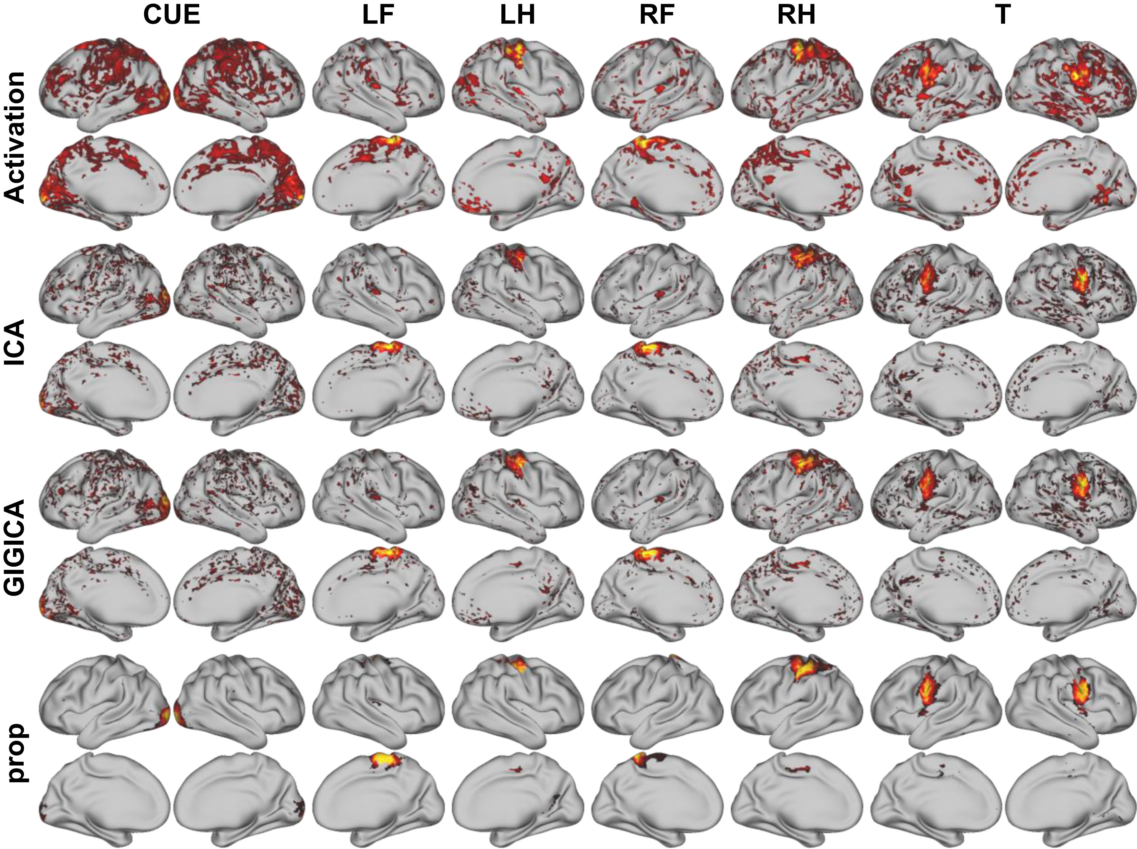
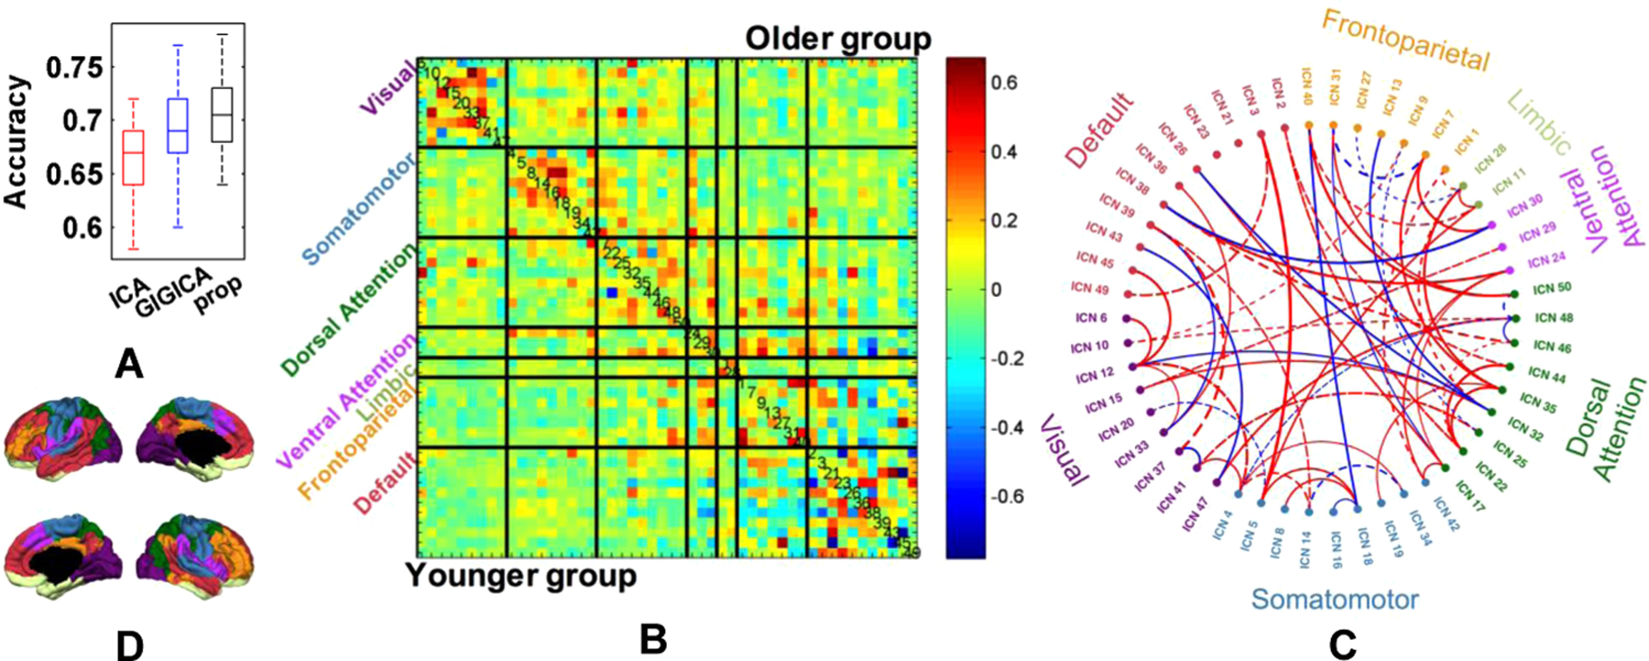
Personalized functional network (pNet) modeling
GSR-NMF: Group Sparsity Regularized Nonnegative Matrix Factorization
Optimize functional coherence of functional networks with enhanced interpretability using NMF
Regularize the personalized functional networks to have common spatial patterns across subjects through group sparsity
GSR-NMF can better delineate personalized functional networks in terms of functional coherence and yield functional connectivity measures with better discriminative performance for distinguishing subjects with different characteristics. Neuroimage, 2017
Personalized functional networks delineated using rsfMRI tightly aligned with individual-specific activation patterns computed from motor-tasked fMRI data. (LF: left foot, LH: left hand, RF: right foot, RH: right hand, T: tongue, CUE: cue).

Slide 3
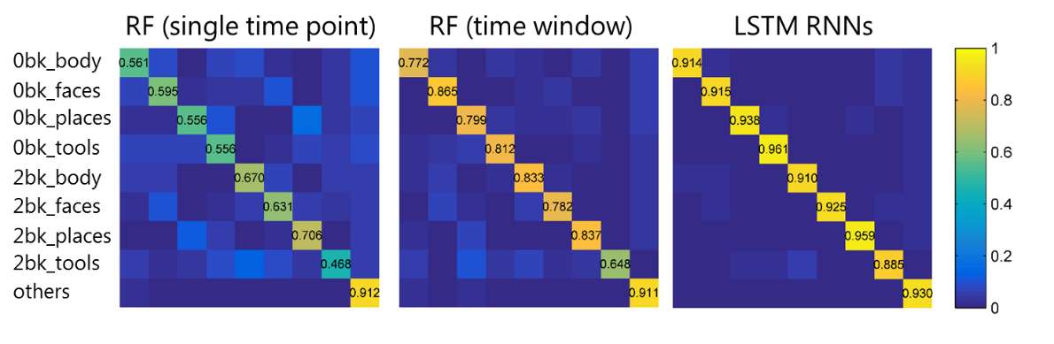
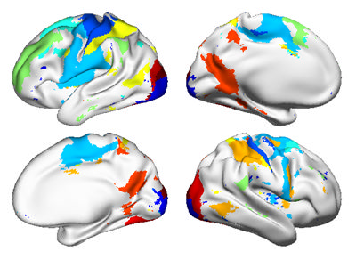
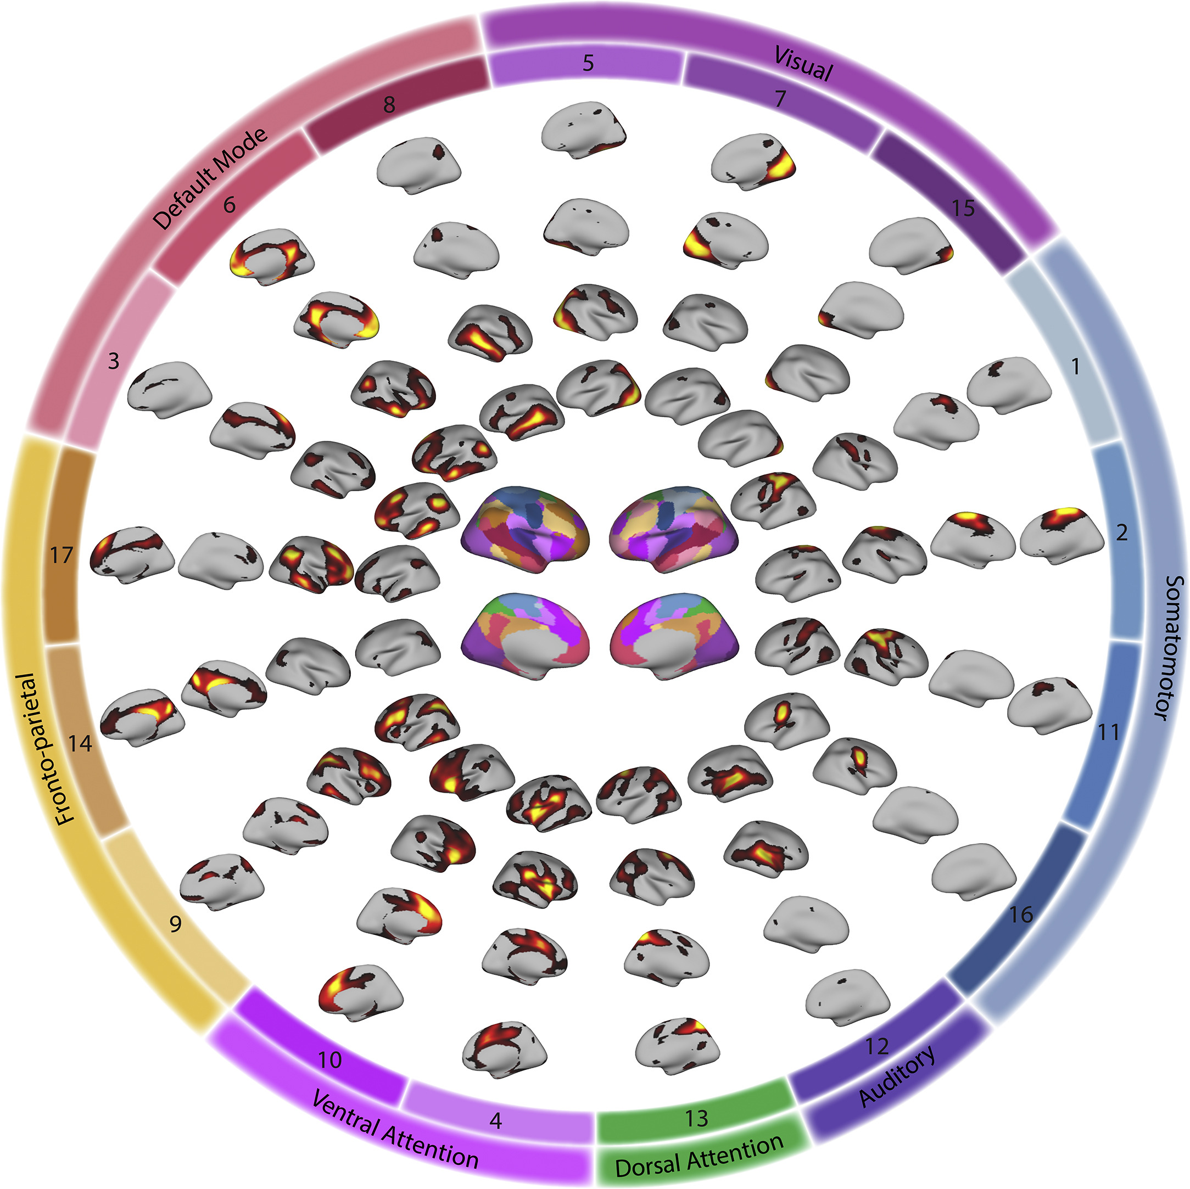
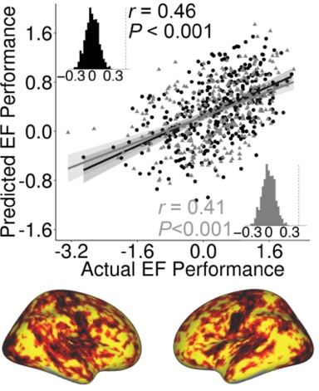
Personalized functional network (pNet) modeling
GSR-NMF: Group Sparsity Regularized Nonnegative Matrix Factorization
Personalized functional networks accurately predict brain states across multiple tasks.
Neuroimage, 2019
Functional topography of the personalized functional networks accurately predicts executive function (Neuron, 2020) and psychopathology (Biol. Psychiatry, 2022), and effectively characterizes sex differences in association networks in youth (PNAS, 2022). The method also enables to identify multi-scale patterns of network re-organization that is related to neurocognitive development (Nature Communications, 2022).
Cui et al., Neuron 20; Biol. Psychiatry 22
The method has been used in large scale studies,
yielding biologically meaningful, statistically significant results

Slide 4
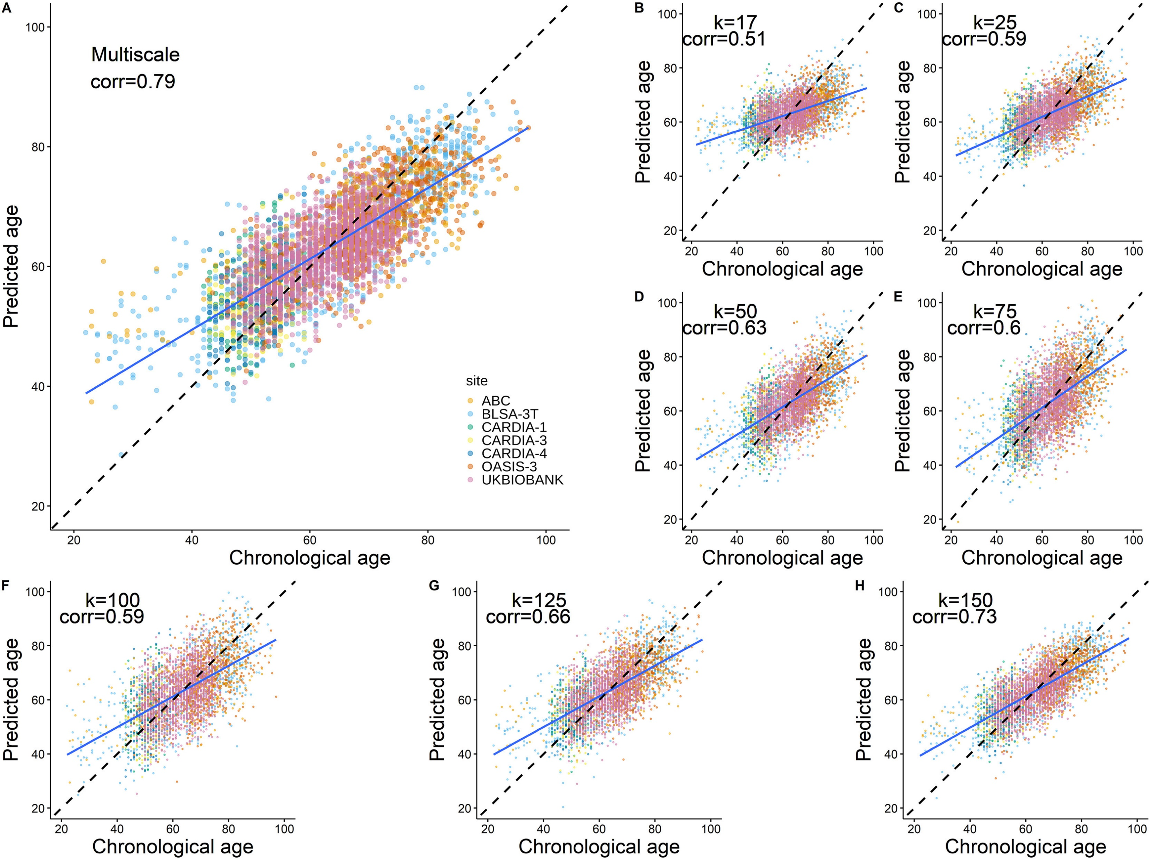
Multiscale functional connectivity patterns of the aging brain learned from harmonized rsfMRI data of niCHART cohorts
GSR-NMF learned personalized functional networks of the aging brain from fMRI scans of 4186 individuals from five cohorts
A machine learning model built on multiscale, harmonized functional connectivity measures achieved accurate brain age prediction
Data harmonization significantly improved the brain age prediction performance
Functional connectivity measures at multiple scales were more informative than those at any single scale for the brain age prediction
Zhou et al., Neuroimage, 2023

Slide 5
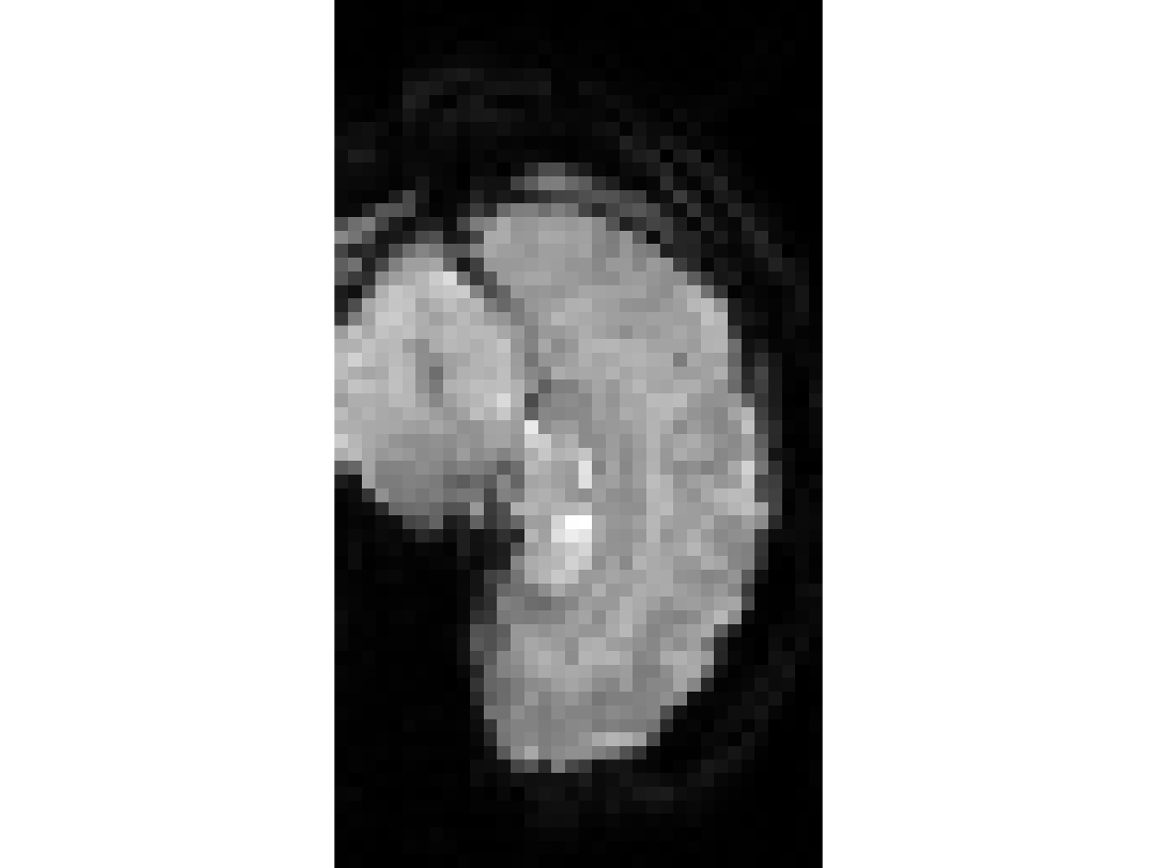
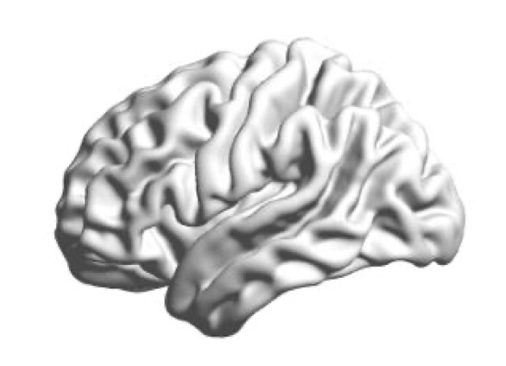
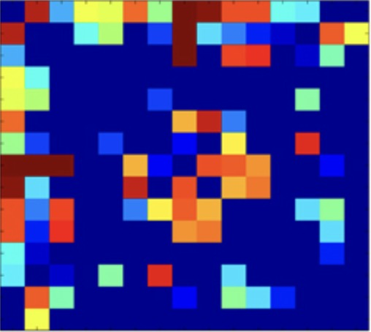
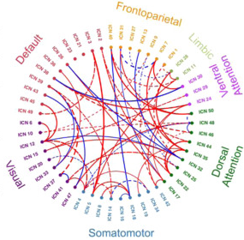
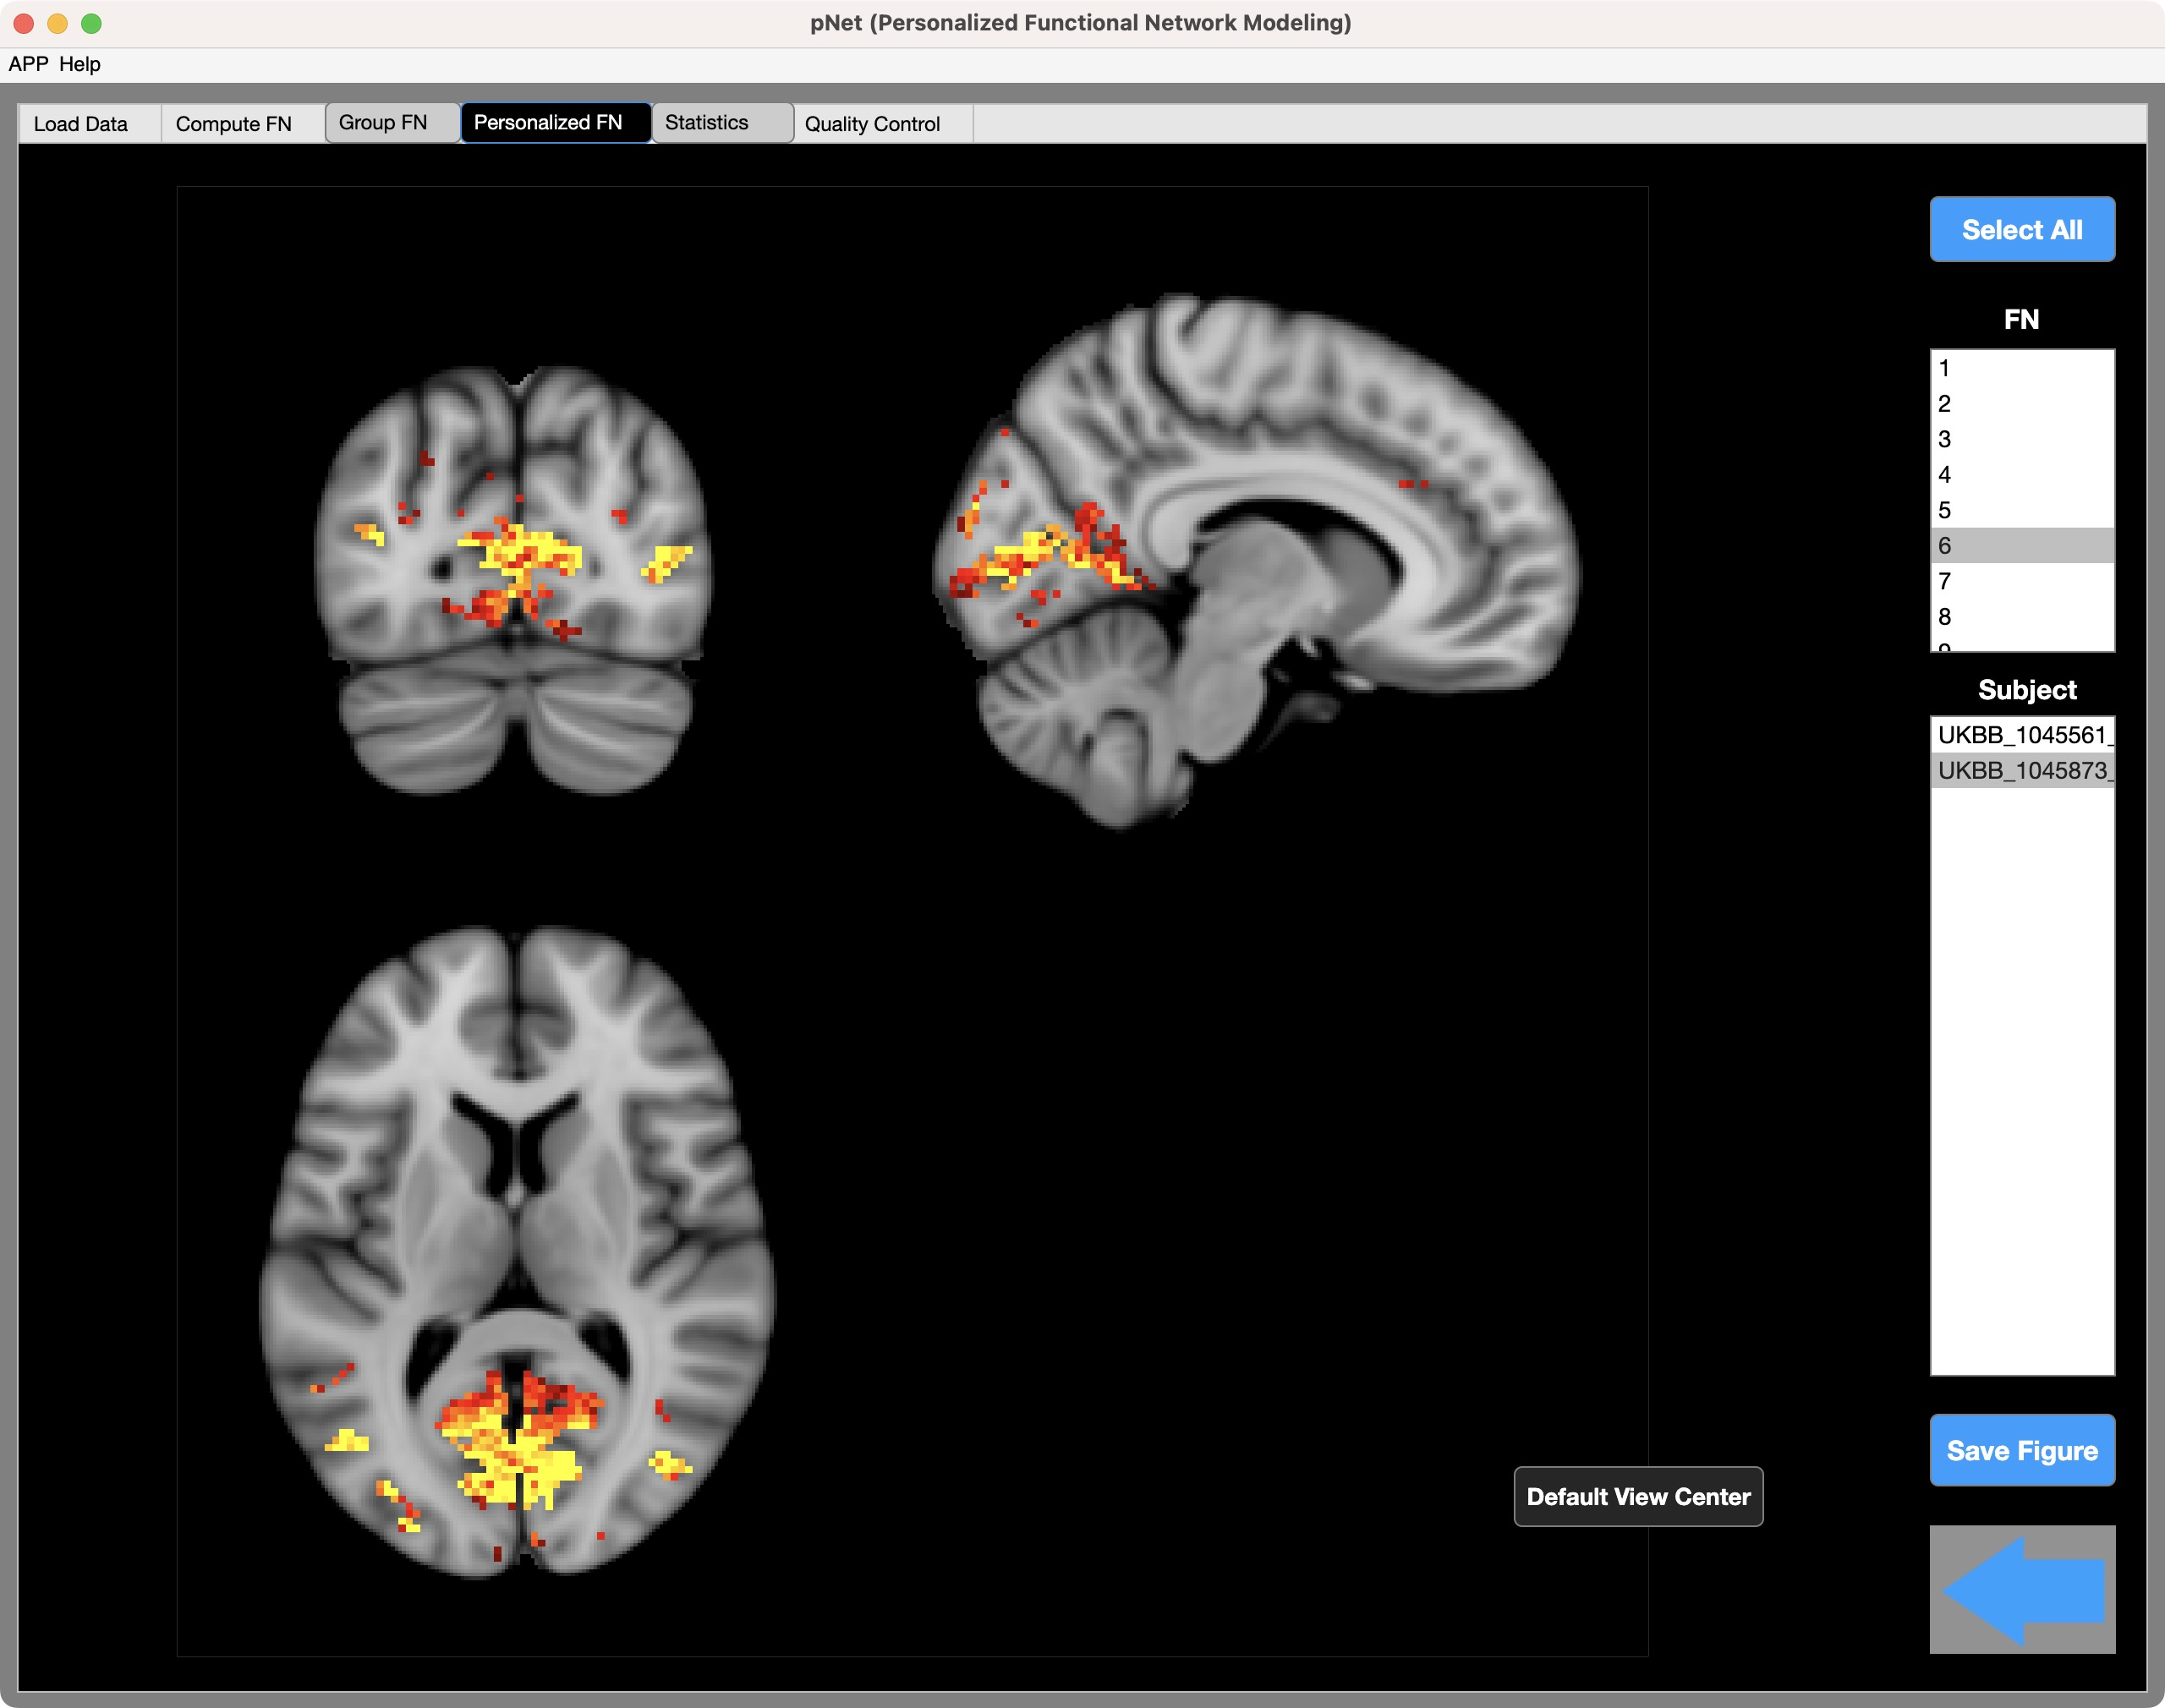
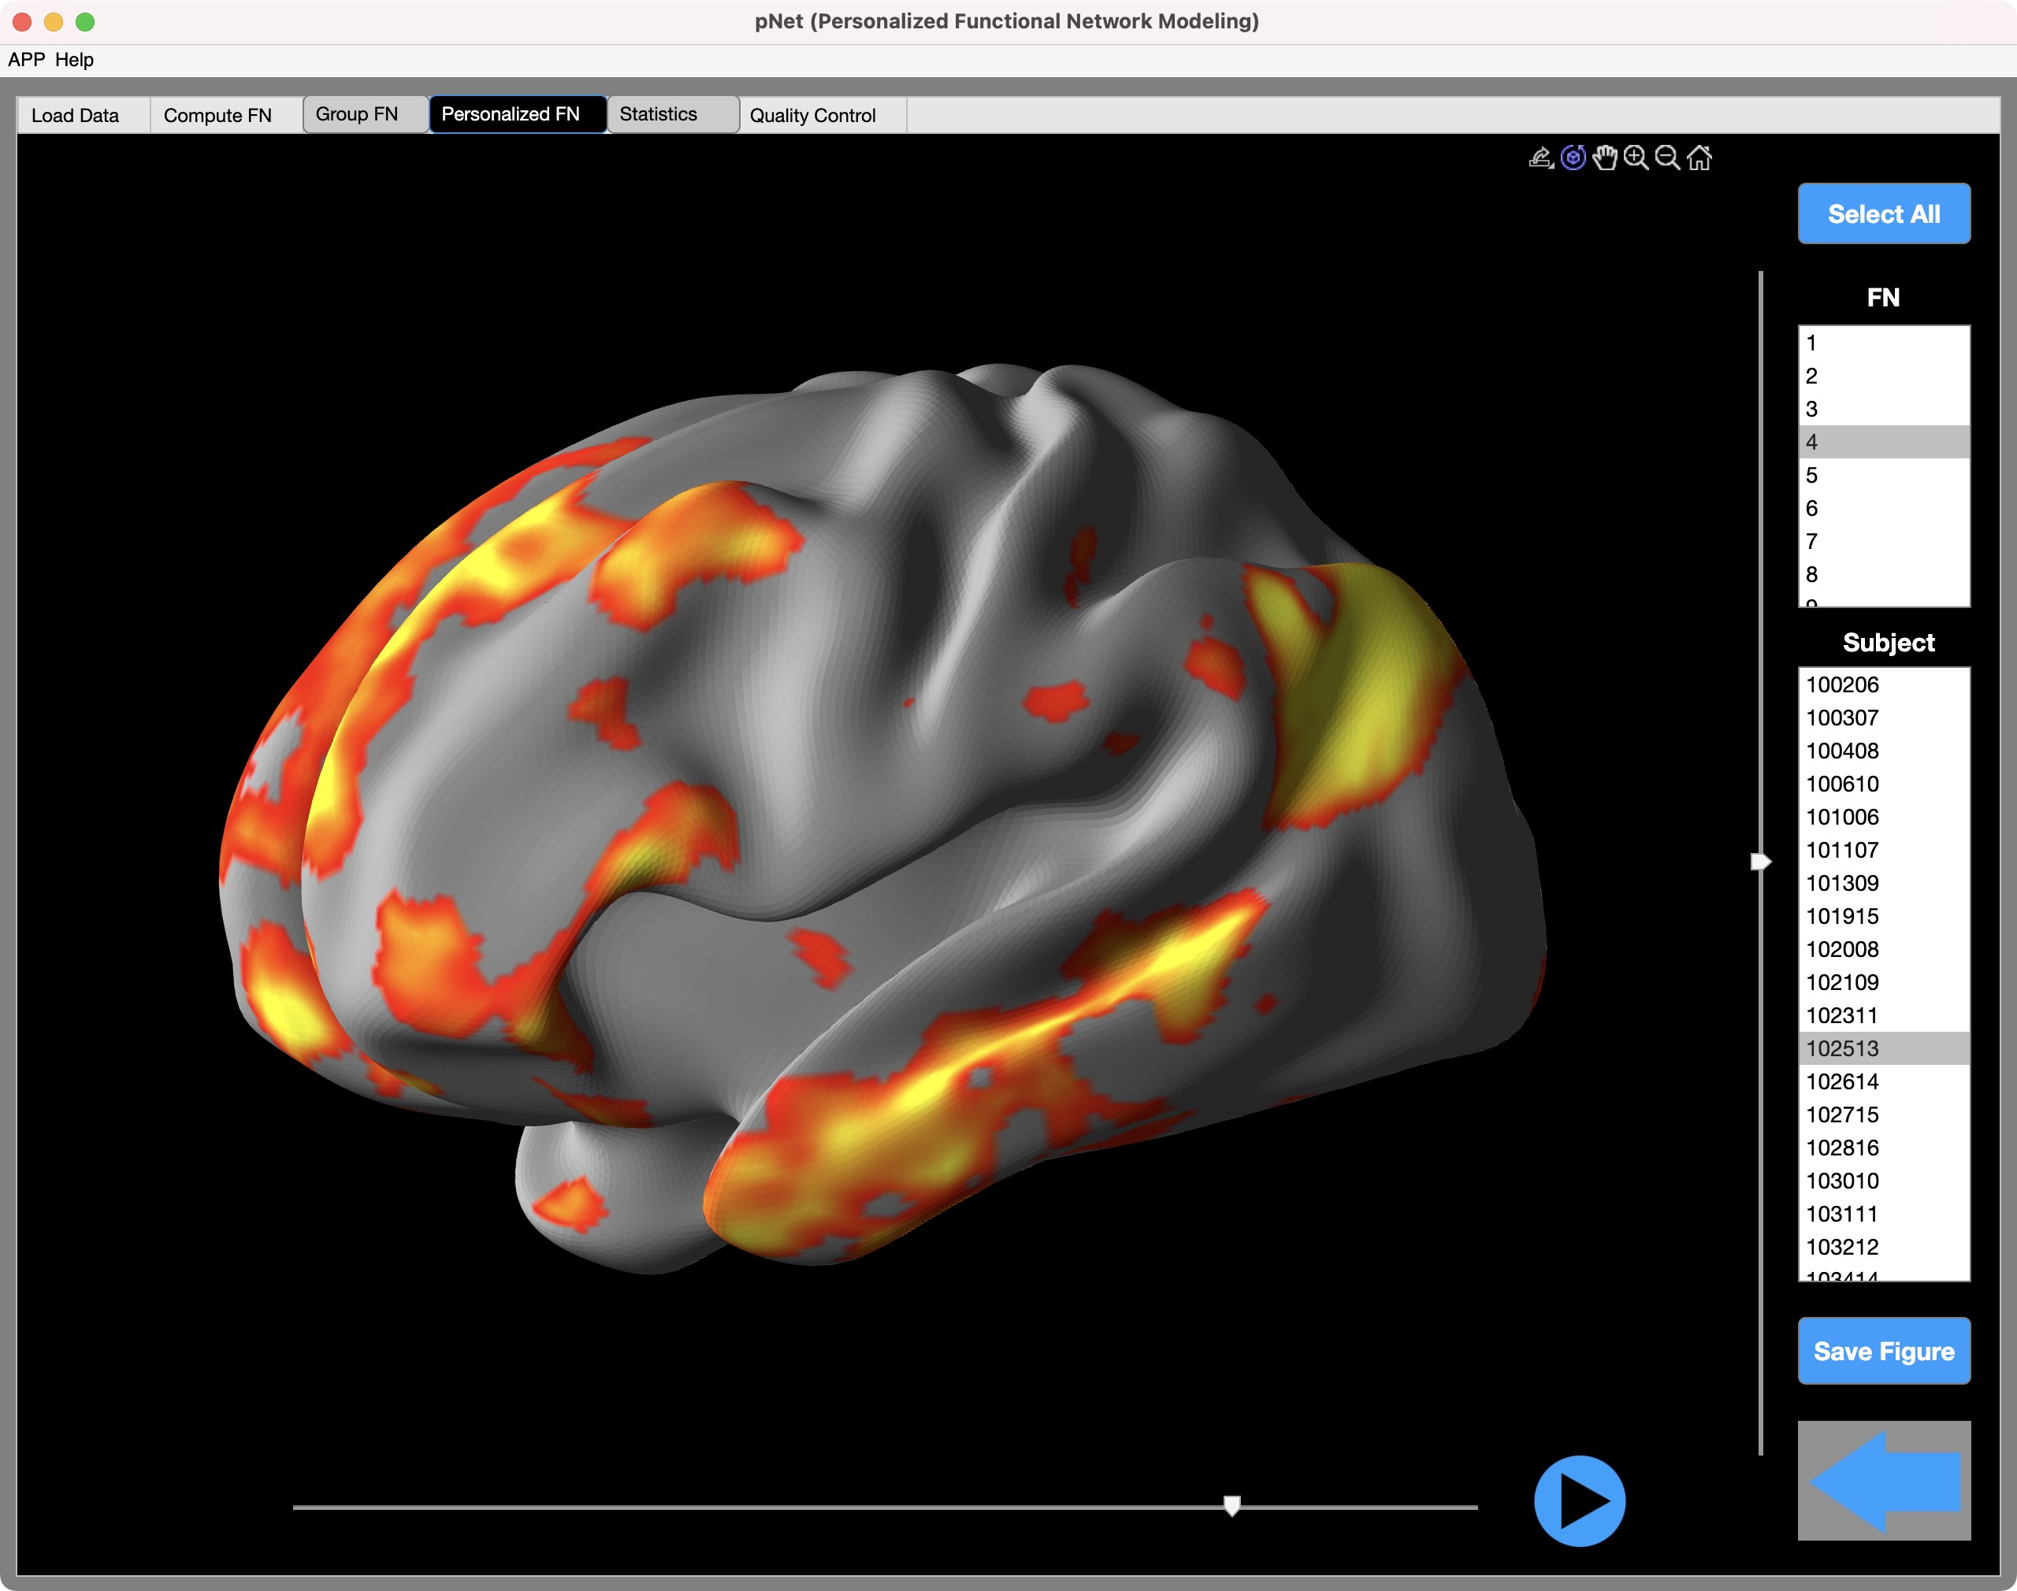
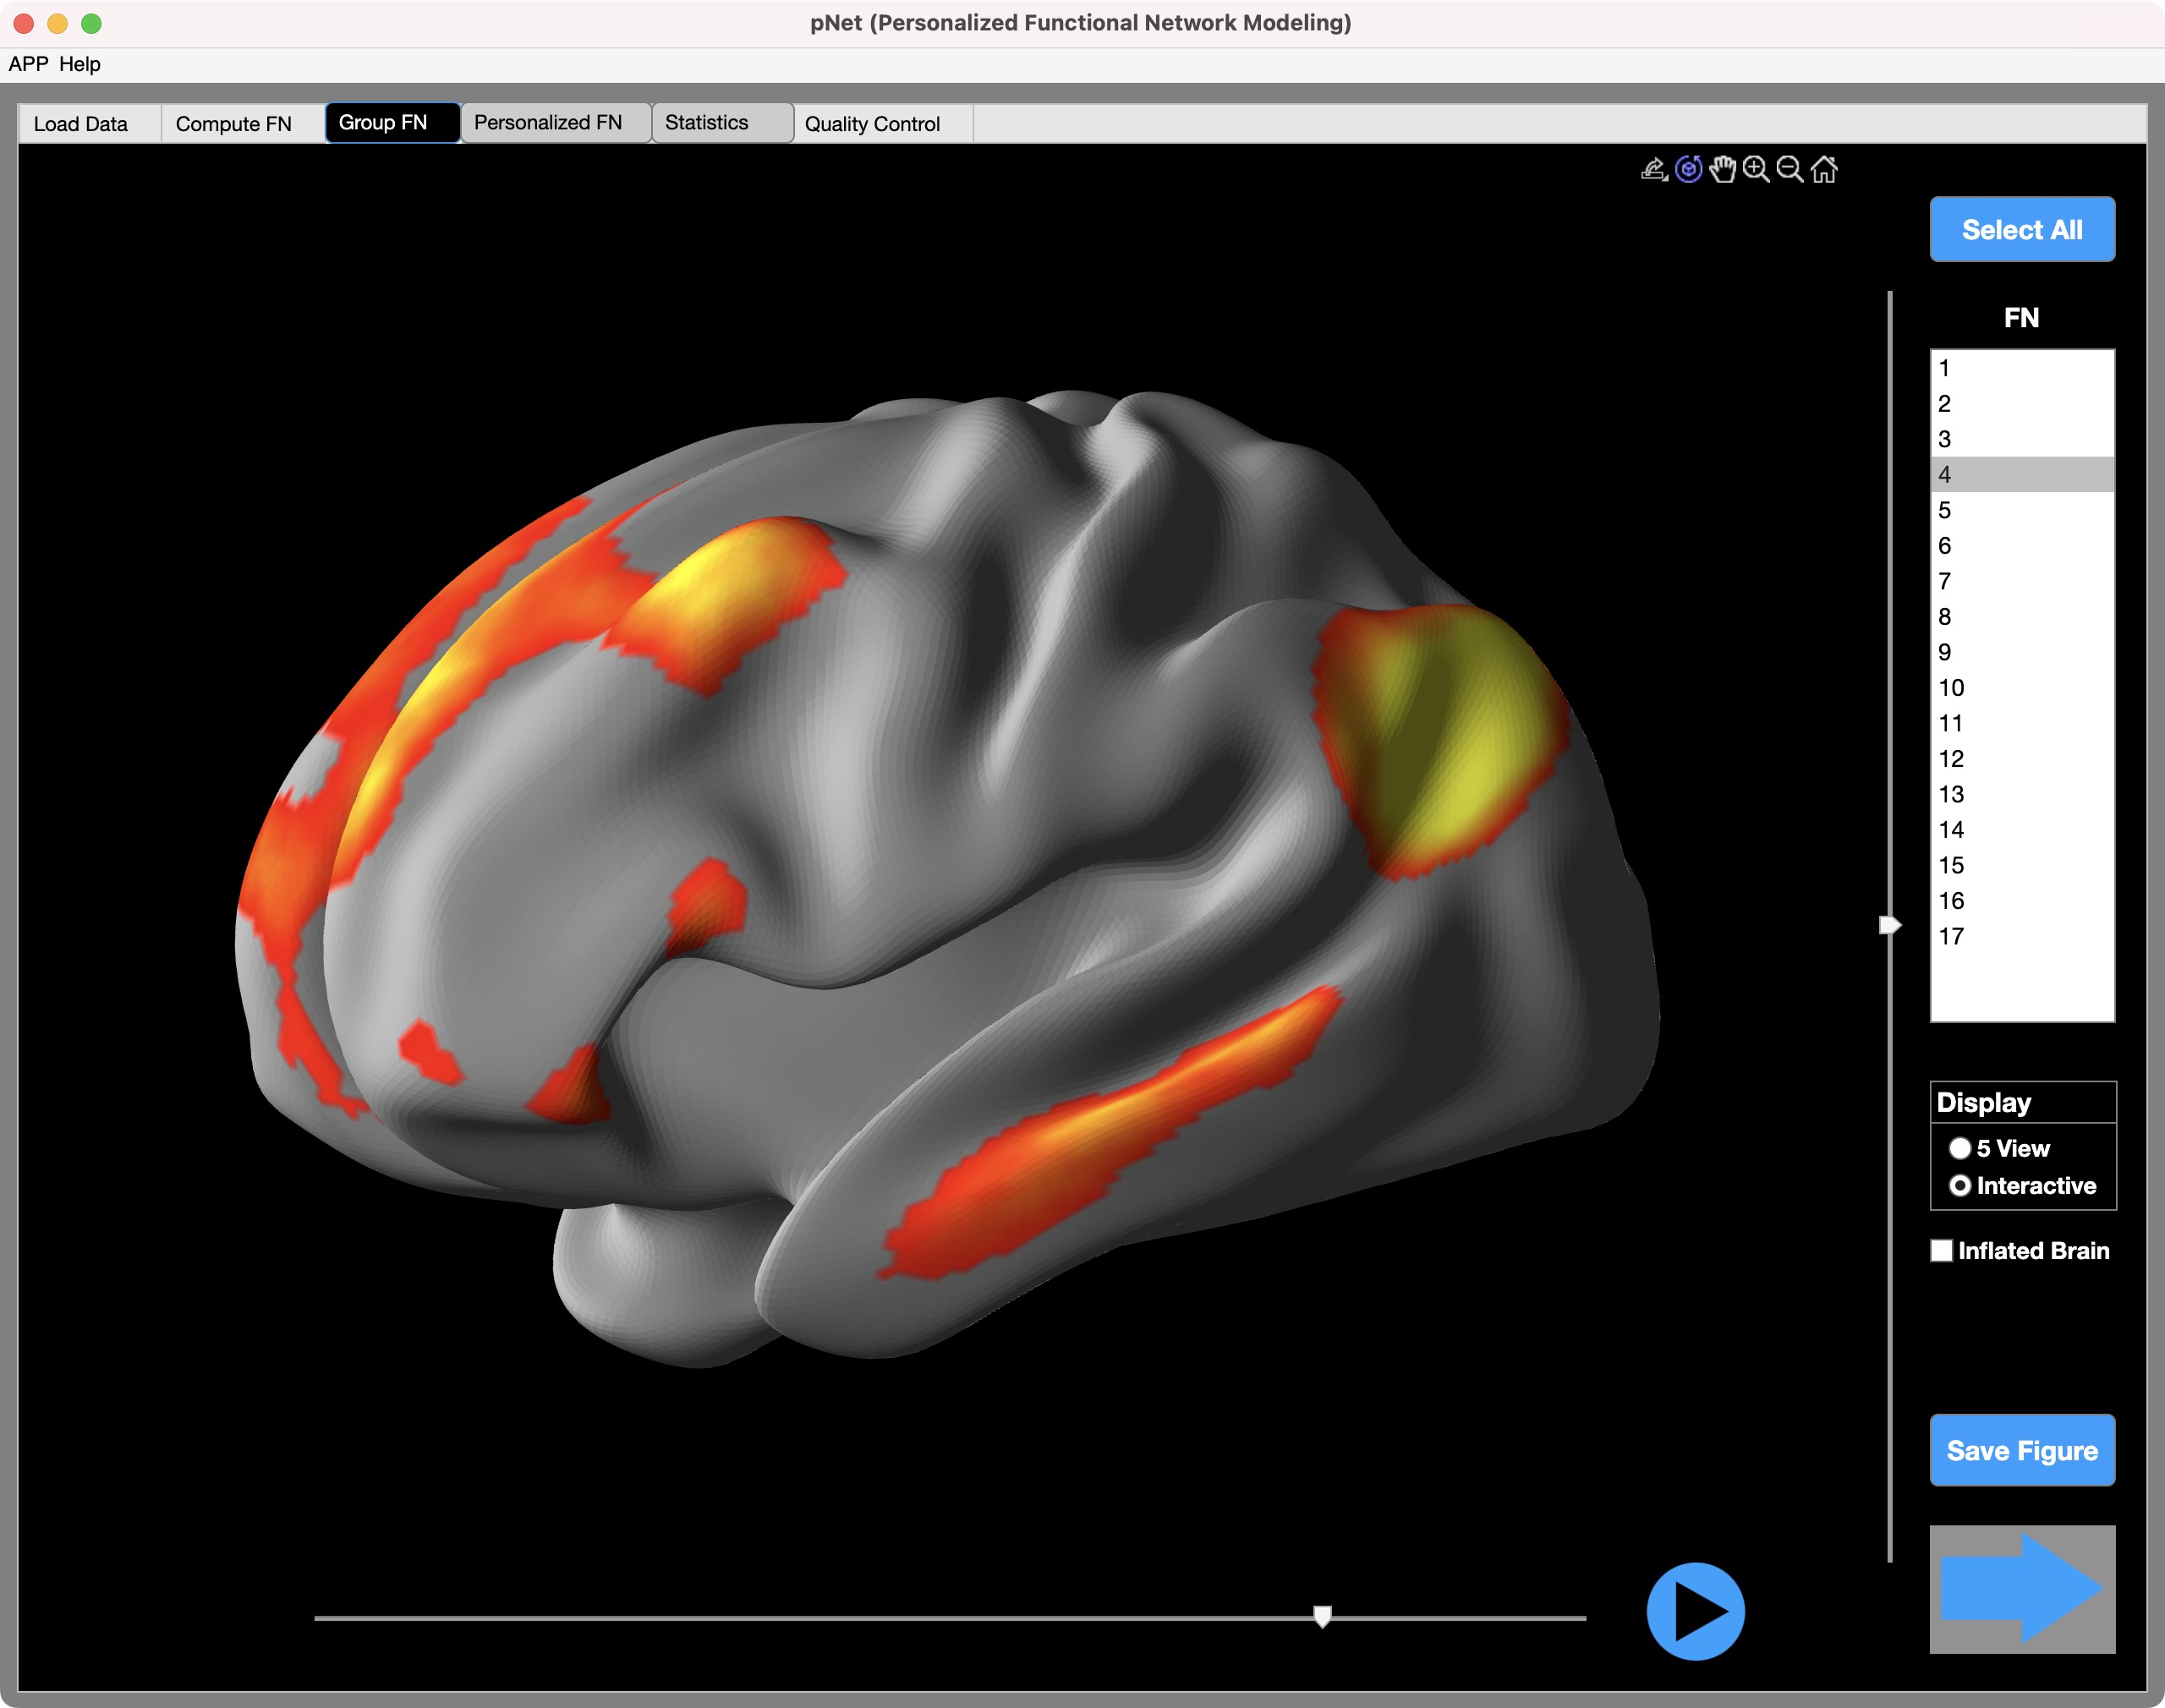
A user-friendly pNet toolbox
Preprocessed fMRI scans
Volume data
4D matrix
t
Surface data
2D matrix
t
Data input
Allow flexible data input from different preprocessing pipelines
Support both volume and surface data types in different formats (NIFTI, CIFTI, MGH, MGZ, MAT)
Optimized python code
Optimize the functional coherence of personalized FNs
Maintain spatial correspondence between group and personalized FNs
Well documented and optimized code scripts
Computation
Spatial components of pFNs
Functional connectivity
FNs and connectivity
Outputs
Volumes
Surfaces
FC matrix
Graph
Functional coherence
Spatial correspondence
Group FN
correspondence
pFN
Quality control
Ensured spatial correspondence
Enhanced functional coherence, higher than their group-level FNs
QC reports

